Slide 1
Skills Bootcamp Classroom Rules
Be on time: Just like in a physical classroom, it's important to be punctual for your online class. Log in to the virtual classroom a few minutes before the class starts.
Turn Cameras on: In order to maximise your learning studies show that being able to see your peers and your tutor being able to see you can increase motivations and retention, therefore we ask to keep your cameras on.
Attend all classes: In order to be successful in your bootcamp studies you need to attend all live sessions, therefore you should prioritise and make time for these sessions.
Avoid distractions: Turn off your phone notifications, close any other unnecessary tabs, and focus solely on the class.
Participate actively: It's important to be an active participant in the class. Ask questions, answer questions, and participate in discussions.
Use proper language and tone: Use respectful language and tone when communicating with your classmates and instructor. Avoid using slang or inappropriate language.
Respect others' opinions: Be respectful of others' opinions, even if they differ from your own. Avoid making negative comments or attacking others.
Follow the instructor's guidelines: Follow the instructor's guidelines, such as submitting assignments on time.
Be polite: Be polite and respectful to everyone in the class, including the instructor, classmates, and guest speakers.
Dress appropriately: Even though you are not in a physical classroom, it's important to dress appropriately. Dress as if you were going to a face-to-face class.
Use appropriate technology: Ensure that you have the necessary equipment, such as a reliable internet connection, a microphone, and a webcam, and that they are in good working condition.

Slide 2
Software Developer Bootcamp
Unit 1 – Introduction to Software Development
Week 2C

Slide 3
Learning Outcomes
Following this session, you should be able to:
Understand why there is a need to follow good coding practices
Explain the benefits of version control when updating code
Notes:
Today, we're going to explore two cornerstones of effective software development: good coding practices and version control. These aren't mere buzzwords; they're practical tools that can significantly impact the quality of your work and your team's efficiency.

Slide 4
Need to Follow Good Coding Practices

Slide 5

What is Good Coding Practice?
Good coding practices are the standards and conventions that developers use to write code that is easy to read, maintain, and debug.
These practices include writing code that is well-structured, organized, and documented.
Notes:
Good coding practices are essentially a set of guidelines, rules, and principles that help you write high-quality code. These practices range from simple naming conventions to more complex concepts like modularisation and code commenting. Why should we adhere to these practices? The answer is simple yet profound: the long-term health of your software project and the well-being of your development team depend on it.

Slide 6

Benefits of Good Coding Practices
Good coding practices can help to reduce the amount of time and effort needed to develop and maintain software.
It can also help to reduce the number of bugs and errors in the code, making it easier to debug and fix problems.
Good coding practices can also help to make the code more readable and understandable, making it easier for other developers to work with.
Notes:
One of the most significant advantages of good coding practices is that they make your code more maintainable. This means the code is easier to debug, update, and understand, saving time and resources in the long run.

Slide 7

Common Coding Practices
Some of the most common coding practices include using meaningful variable and function names, writing code that is well-structured and organized, and using comments to explain the code.
It is also important to use consistent formatting and indentation, and to avoid using unnecessary code.

Slide 8

Best Practices for Writing Clean Code
When writing code, it is important to use best practices such as writing code that is easy to read and understand, using meaningful variable and function names, and avoiding unnecessary code.
It is also important to use consistent formatting and indentation, and to use comments to explain the code.
Notes:
Following good coding practices can help to reduce the amount of time and effort needed to develop and maintain software, and can also help to reduce the number of bugs and errors in the code.

Slide 9

Tools for Writing Clean Code
There are a number of tools available to help developers write clean code, such as code linters, code formatters, and code analyzers.
These tools can help to identify potential problems in the code, and can also help to ensure that the code is well-structured and organized.

Slide 10

The Importance of Testing
Testing is an important part of writing clean code, as it helps to ensure that the code is working as expected.
Testing can also help to identify potential bugs and errors in the code, and can help to ensure that the code is well-structured and organized.

Slide 11

The Benefits of Refactoring
Refactoring is the process of restructuring existing code to make it more efficient and easier to maintain.
Refactoring can help to reduce the amount of time and effort needed to develop and maintain software, and can also help to reduce the number of bugs and errors in the code.

Slide 12
Benefits of Version Control When Updating Code

Slide 13

What is Version Control?
Version control is a system that records changes to a file or set of files over time so that you can recall specific versions later.
It allows you to revert files back to a previous state, revert the entire project back to a previous state, compare changes over time, see who last modified something that might be causing a problem, who introduced an issue and when, and more.
Notes:
Version control systems, often abbreviated as VCS, are tools that help manage changes to a codebase. They are indispensable for tracking changes, reverting to previous versions, and enabling effective collaboration among team members. Version control is not a luxury but a necessity in today's fast-paced software development environment. We'll delve into a range of benefits in the following slides.

Slide 14

Benefit 1: Easier Collaboration
Version control makes it easier for multiple people to work on the same project at the same time without stepping on each other's toes.
It allows multiple developers to work on the same codebase without having to worry about overwriting each other's changes.
It also allows developers to easily share their changes with the rest of the team, making collaboration much easier.
Notes:
When everyone on the team follows the same set of coding practices, it becomes much easier to collaborate. The codebase becomes consistent, making reading and understanding each other's code easier.

Slide 15

Benefit 2: Easier to Find and Fix Bugs
Version control makes it easier to find and fix bugs in your code.
It allows you to easily compare different versions of the code to see what has changed and pinpoint where the bug might be.
It also allows you to easily revert back to a previous version if the bug is too difficult to fix.
Notes:
One of the most significant advantages of good coding practices is that they make your code more maintainable. This means the code is easier to debug, update, and understand, saving time and resources in the long run.

Slide 16

Benefit 3: Easier to Test and Deploy Code
Version control makes it easier to test and deploy code.
It allows you to easily create different versions of the code for testing purposes, and then easily switch back to the original version if needed.
It also allows you to easily deploy different versions of the code to different environments, such as staging and production, without having to worry about overwriting each other's changes.
Notes:
Version control systems often integrate seamlessly with continuous integration and continuous deployment tools. This makes automating the testing and deployment processes easier, ensuring your code is always deployable.

Slide 17

Benefit 4: Easier to Revert Changes
Version control makes it easier to revert changes if something goes wrong.
It allows you to easily revert back to a previous version of the code if something goes wrong, without having to manually undo all the changes.
It also allows you to easily compare different versions of the code to see what has changed and pinpoint where the issue might be.
Notes:
Think of version control as a safety net. If you make a mistake or something breaks, you can easily revert to a previous code version. This backup mechanism can be a lifesaver in critical situations.

Slide 18

Benefit 5: Easier to Track Changes
Version control makes it easier to track changes over time.
It allows you to easily see who made what changes and when, which can be helpful for debugging and understanding the codebase.
It also allows you to easily compare different versions of the code to see what has changed and pinpoint where the issue might be.

Slide 19

Benefit 6: Easier to Manage Multiple Projects
Version control makes it easier to manage multiple projects at the same time.
It allows you to easily switch between different versions of the code for different projects, without having to manually copy and paste code.
It also allows you to easily compare different versions of the code to see what has changed and pinpoint where the issue might be.

Slide 20

Benefit 7: Easier to Share Code
Version control makes it easier to share code with others.
It allows you to easily share different versions of the code with others, without having to manually copy and paste code.
It also allows you to easily compare different versions of the code to see what has changed and pinpoint where the issue might be.
Notes:
One of the most significant benefits of version control is that it simplifies collaboration. Features like branching and merging allow multiple team members to work on different aspects of a project simultaneously without interfering with each other's work.

Slide 21
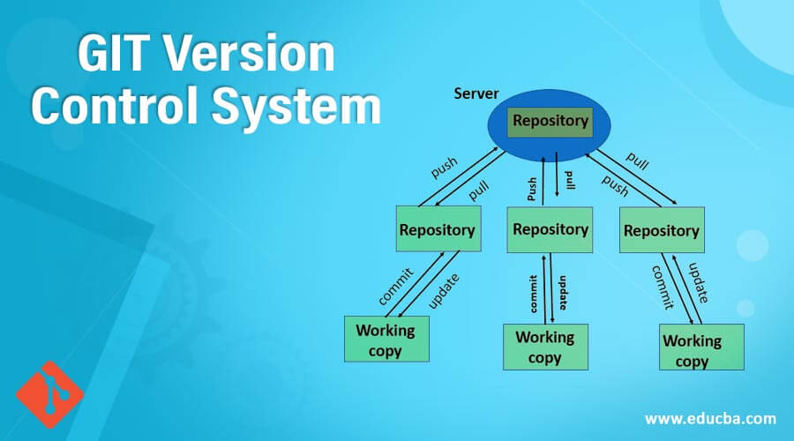
Popular Version Control Systems
Git: Git is a distributed version control system that is widely used for its speed, flexibility, and strong branching and merging capabilities, making it the go-to choice for open-source and collaborative projects.
SVN: Subversion (SVN) is a centralised version control system that provides a more traditional approach to version control, offering fine-grained access control and the ability to handle binary files efficiently.
Mercurial: Mercurial is a distributed version control system known for its simplicity and performance, making it well-suited for both small and large projects.
Notes:
Version control is an essential tool for any developer, as it makes it easier to collaborate, find and fix bugs, test and deploy code, revert changes, track changes, manage multiple projects, and share code.
It is a powerful tool that can save you time and make your life as a developer much easier.

Slide 22
Activity 15 mins: Find out some more good coding practices not mentioned today

Slide 23
Learning Outcomes
Following this session, you should be able to:
Understand why there is a need to follow good coding practices
Explain the benefits of version control when updating code

Slide 24

Questions?

Slide 25
Thank You

